Slide 1
EUCALL Mid-Term Review – WP 4
Adrian P. Mancuso – WPL
*
*
*
*
*
Notes:
How to edit the title slide
Upper area: Title of your talk, max. 2 rows of the defined size (36 pt)
Lower area (subtitle): your name and affiliation, max. 1 rows of the defined size (28 pt)

Slide 2

Outline
Main WP objectives
Main WP achievements
  Software developments in SIMEX
  Scientific applications (including deviations from proposal)
Upcoming Milestones and Deliverables
Outlook: SIMEX++

Slide 3
SIMEX objective

Slide 4

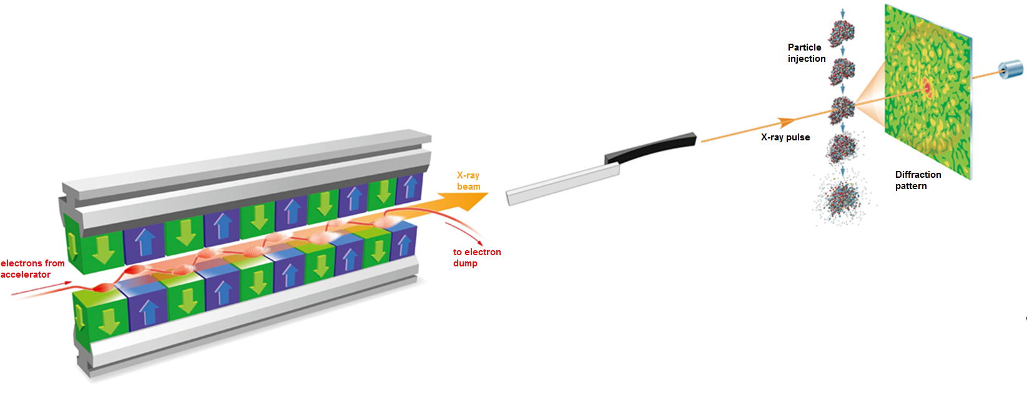
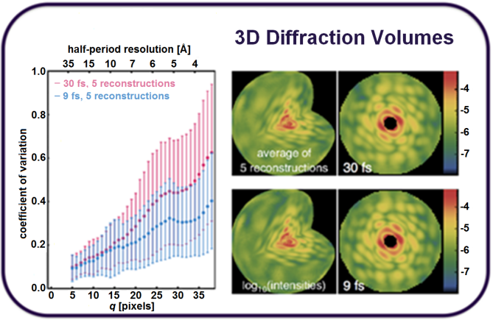
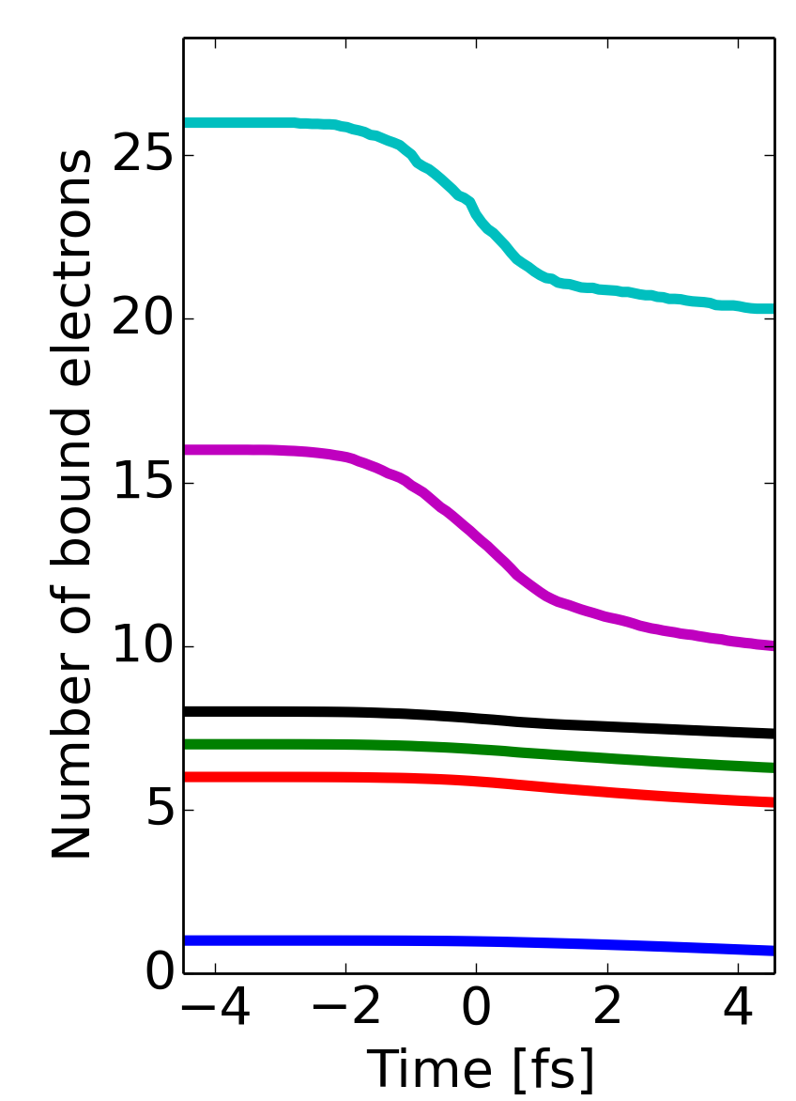
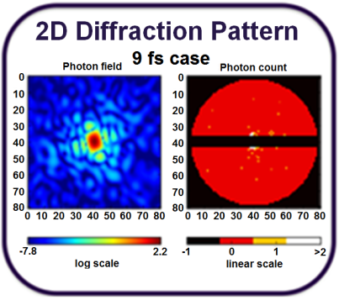
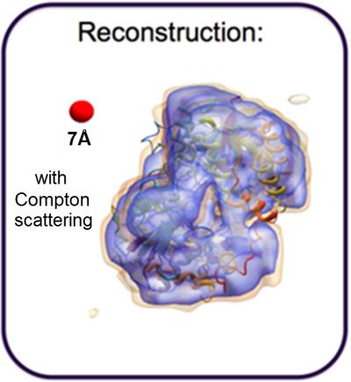
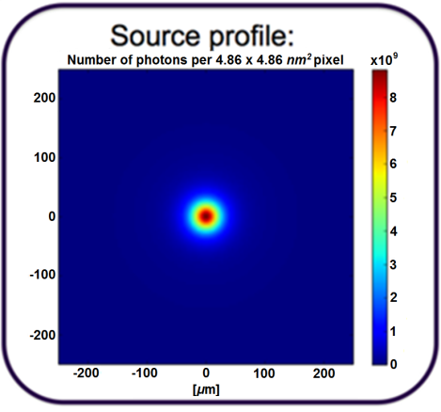
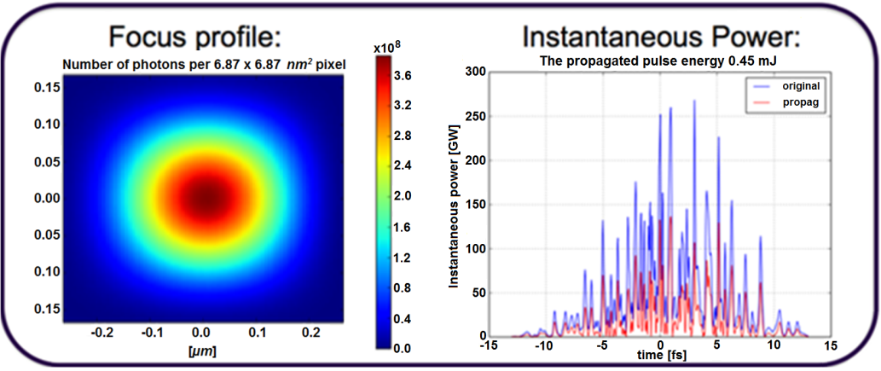
SIMEX' objective
The key objective of SIMEX is to develop a simulation
platform for users and facility operators to simulate
experiments “from source to detector” at advanced
light sources.
Target/Sample
Atoms, molecules, clusters
Solids, surfaces
Liquids
Plasmas
Yoon et al. Scientific Reports 6 24791 (2016)
Fortmann-Grote et al. NOBUGS (2016)
Photon Data Analysis
Structure determination
Electronic structure
Transport
Relaxation &
Thermodynamics
Fortmann-Grote et al. SPIE Proceedings (2017)
Diagnostics
Spectroscopy
Diffraction
Scattering
Photon propagation
Lenses
Mirrors
Apertures
Gratings
Monochromators
Coherent, incoherent
Photon Source
XFEL
Synchrotron
Optical Laser
Pump-probe

Slide 5
Timeline
Software development Reports & data generation
D1: Short pulse laser matter interaction software
M1: Single modules interoperable
D2: Long pulse laser matter interaction software
M2: First example simulation
2016
M3: Simulations interoperable
D3: Interoperability of simulation workflows
70%
50%
2017
D4: Generation of coherent scattering data
50%
D5: Testing & validation
20%
2018
M4: Tested and documented simulation code
10%

Slide 6
The dimensions of SIMEX
Research Infrastructures
Research Areas
Visualization
HPC
SIMEX
Data handling
User Interfaces
Frameworks
Validation

Slide 7
Summary of achievements until midterm

Slide 8
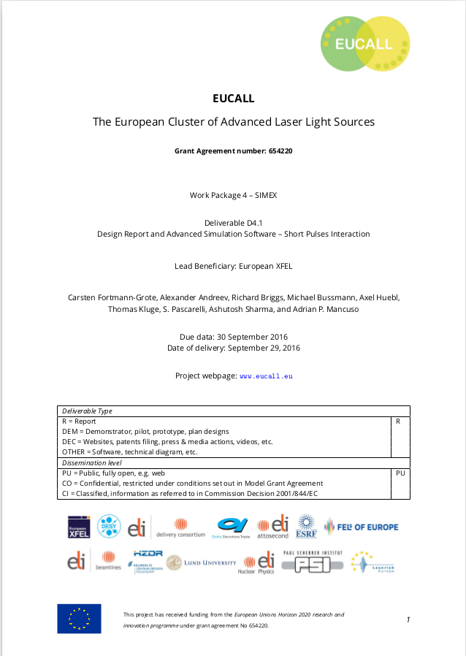

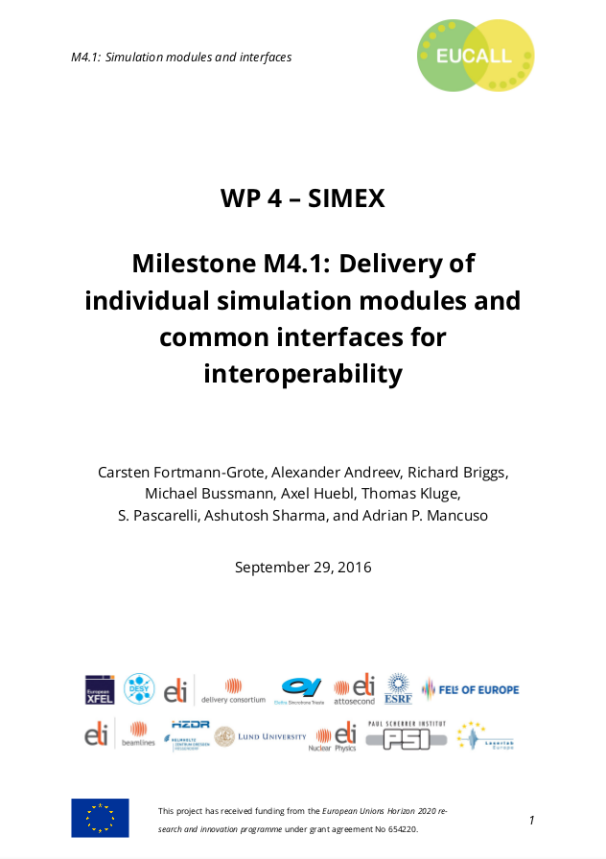
Documentation of SIMEX achievements

Slide 9
Publications out of SIMEX
C. Fortmann-Grote et al., Start-to-end simulation of single particle imaging using ultra-short pulses at the European X-ray Free Electron Laser, IUCrJ (submitted)
C. Fortmann-Grote et al., Simulations of ultrafast x-ray laser experiments, SPIE Optics & Optoelectronics Conference Proceedings, Prague (2017)
C. Fortmann-Grote et al., SIMEX: Simulation of Experiments at Advanced Light Sources, in “New Opportunities for Better User Group Software” Conference Proceedings, 29 (2017); doi:10.17199/NOBUGS2016.21 (published May 2017)
E. Zenker et al., Alpaka – An Abstraction Library for Parallel Kernel Acceleration 2016 IEEE International Parallel and Distributed Processing Symposium Workshops, (IPDPSW) 00: 631-640 (2016); doi: https://doi.org/10.1109/IPDPSW.2016.50
E. Zenker et al., Performance-Portable Many-Core Plasma Simulations: Porting PIConGPU to OpenPower and Beyond, Lecture Notes in Computer Science, 9945: 293-301 (2016); doi: http://dx.doi.org/10.1007/978-3-319-46079-6_21

Slide 10
SIMEX provides user interfaces and data formats for start-to-end photon experiment simulations
Photon source
FEL
Synchrotron
Plasma source
Optical Laser
Photon propagation
Wave Optics
Ray optics
Photon-Matter Interaction
Molecular Dynamics
Particle-In-Cell
Radiation-Hydrodynamics
Source radiation field
Focus radiation field
Sample trajectory
Electronic structure
Atom positions
Density, temperature, pressure
Data analysis
Structure finding
Dynamics
Thermodynamics
Detector
Pixel area detector
Spectrometer
Photon scattering,
emission, absorption
Results
Detector response
Photon-Matter interaction products
Scattered photons
Emitted photons
Secondaries (e⁻, ions)
Calculators: Scriptable (python) interfaces to advanced simulation codes
Data interfaces using metadata standards

Slide 11
Simulation codes in SIMEX

Slide 12
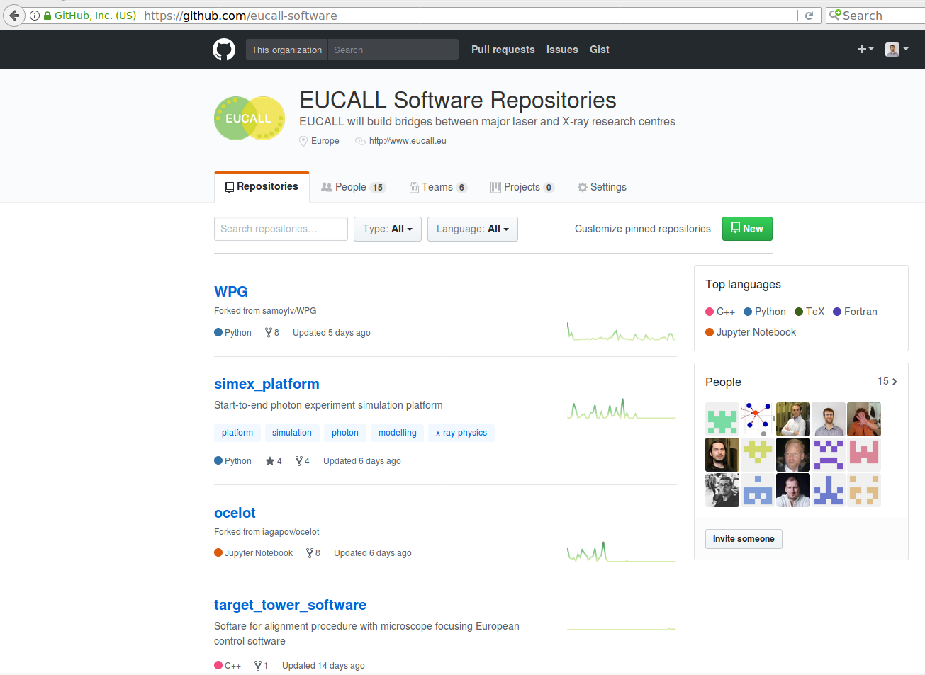
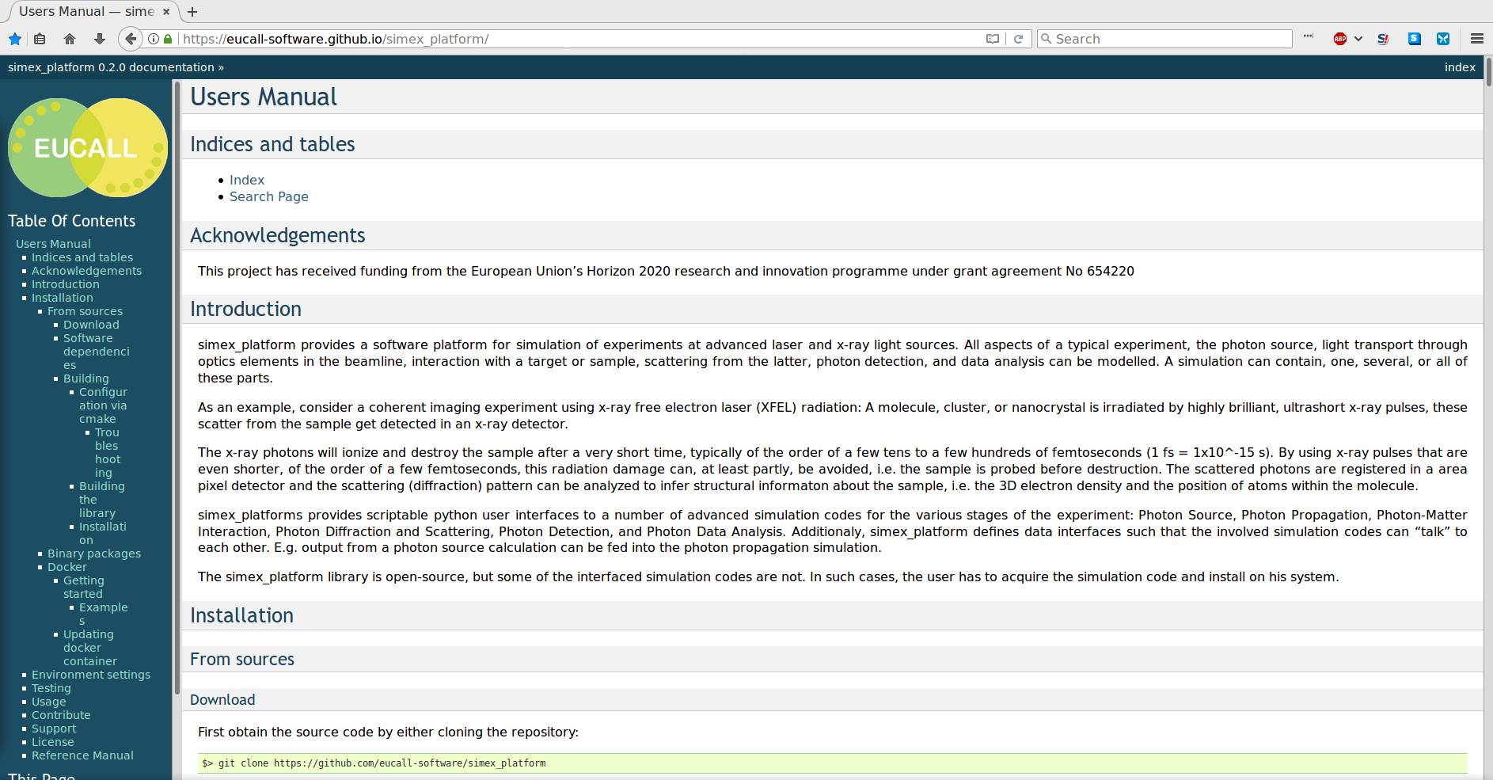
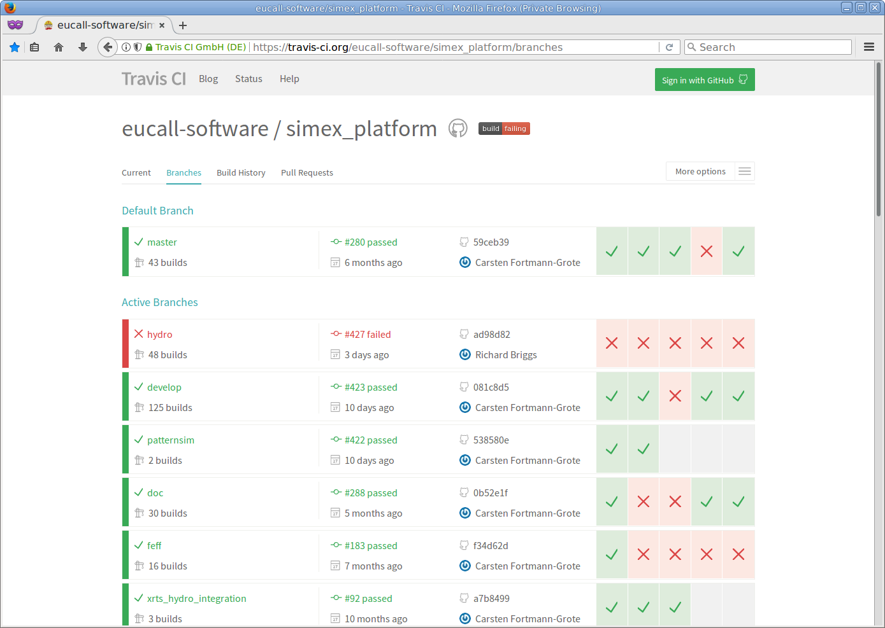
SIMEX is developed as an opensource
project on github

Slide 13
Achievements in WP4 in reporting period
Identified and collected simulation codes (→ Task 4.1)
Simulation platform and generic user interfaces (python) to simulation codes (→ WP objective)
Data interfaces based on simS2E [Yoon et al. (2016)] and metadata standards (→ Task 4.1)
Design of start-to-end simulations for pump-probe experiments
    Short-pulse optical laser + XFEL (→ D4.1)
    Long-pulse optical laser + Synchrotron/XFEL (→ D4.2)
Adaptation of simulation codes for HPC platforms and code optimizations, including virtualization and packaging (→ T 4.3)

Slide 14
Achievements in WP4 in reporting period
Identification of scientific applications and required experimental parameters (OL, x-ray photons, detector)
    Single particle imaging @ European XFEL (→ Tasks 4.1, 4.2.1)
    Coherent imaging of hot dense plasmas far from equilibrium @ European XFEL (→ D4.2, Tasks 4.1, 4.2.2)
    Optimization of target geometry and laser pulse profiles in dynamic compression studies + x-ray absorption spectroscopy @ ESRF (→ D4.1, Tasks 4.1, 4.2.2, 4.3.2)
    Compact x-ray sources based on electron laser-wakefield acceleration in short-pulse laser-matter interaction @ ELI-ALPS (→ Tasks 4.1.2, 4.2.2) → Extension of proposal

Slide 15
Ongoing activities

Slide 16


Milestones, Deliverables, and Tasks due 9/17 (M24)
M4.2/D4.4/T4.2.1: First example simulation:
  Single-particle imaging at XFEL.EU
  Publication of simulation data
M4.3/D4.3/T4.2.2: Simulations interoperable:
  X-ray sources:
    accelerator based
    plasmas
  Propagation:
    Coherent wave
    X-ray tracing
  Photon-Matter interaction:
    Radiation damage
    short-pulse laser matter interaction
    shock compression
  Signal generation from
    optically thin
    optically thick
    targets
    Publication of simulation data

Slide 17
Remaining tasks in FY2

Slide 18
M36 deliverables and milestones
D4.5/Task 4.3.1: , Benchmarking, testing, validation, example workflow
    Validation against Virus data (AMO@LCLS)
    Validation against C60 data (CXI@LCLS)
    Iterative optimization workflow: Target design for dynamic compression experiments
    Performance benchmarks for selected simulation codes
Task 4.3.2: HPC, data management, data analysis
    SIMEX codes run on modern HPC infrastructures including GPU clusters
    Deployment options: source tarballs, binary packages, docker images
    Webbased SIMEX frontend under development

Slide 19
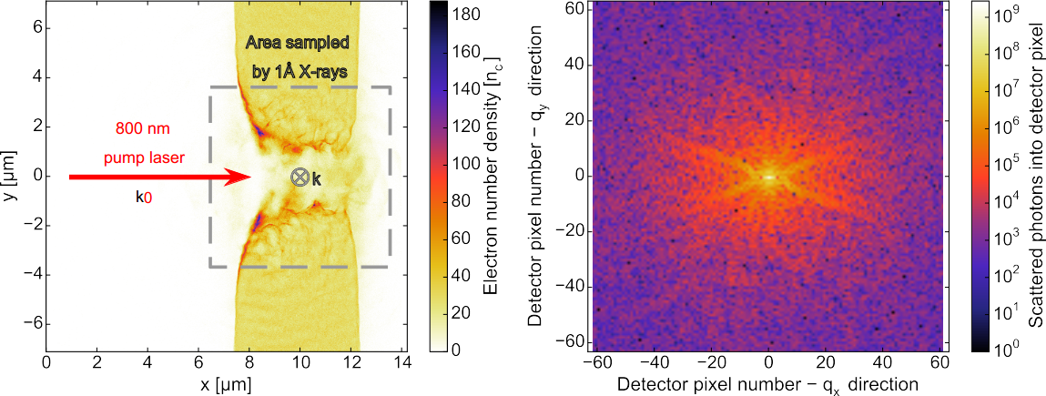

SAXS on high-power laser driven solid targets
Target: 5 μm cryogenic hydrogen
Laser: 800 nm, 30 fs, 105 TW
Probe: 1 Å, 10¹² photons / 50 μm² focus
2D PIC simulation
R.Mishra,Phys.Plasma 20,072704(2013).
SAXS pattern 134 fs after laser pulse
Detector distance 93 cm
Avg. photon count: 10^{5..6} / pixel
SAXS simulation: paraTAXIS code

Slide 20
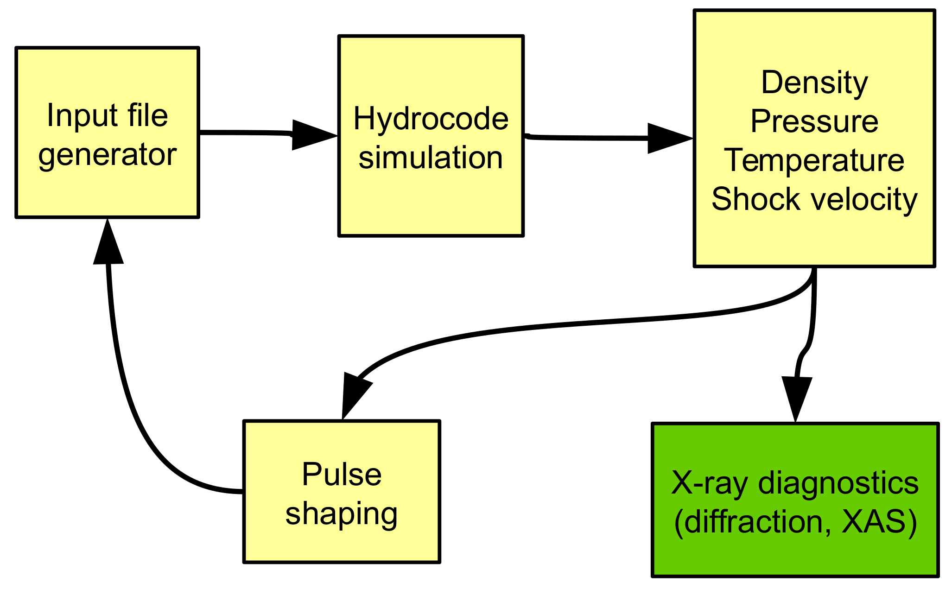
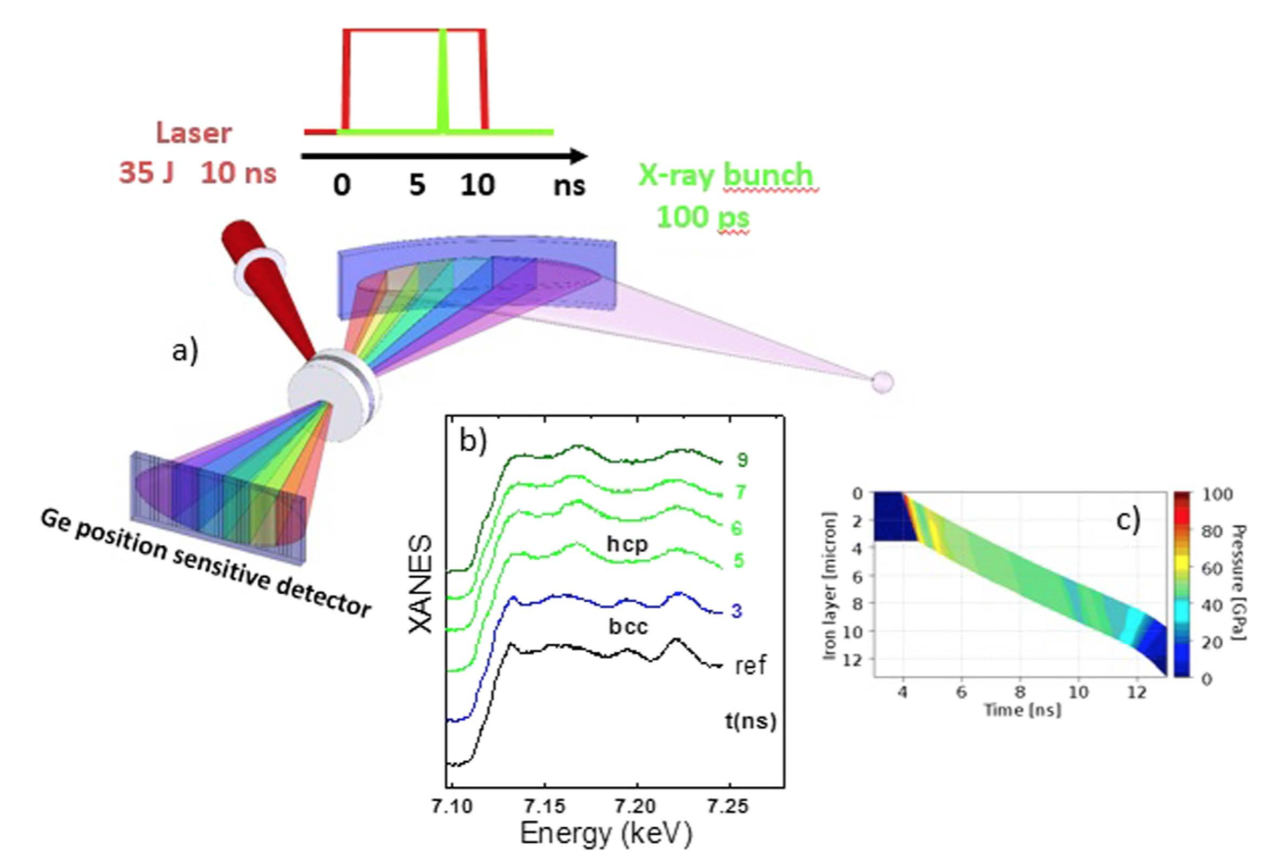

XAFS in warm dense matter
X-ray probing shock compressed warm dense matter (WDM)
Model high energy, long pulse (ns) laser driven shock compression with 1D & 2D radiation hydrodynamic codes
Simulate XAFS (& scattering) signals
Pulse optimization via feedback of simulated signal to pulse shaper
Torchio et al. Scientific Reports (2016)

Slide 21
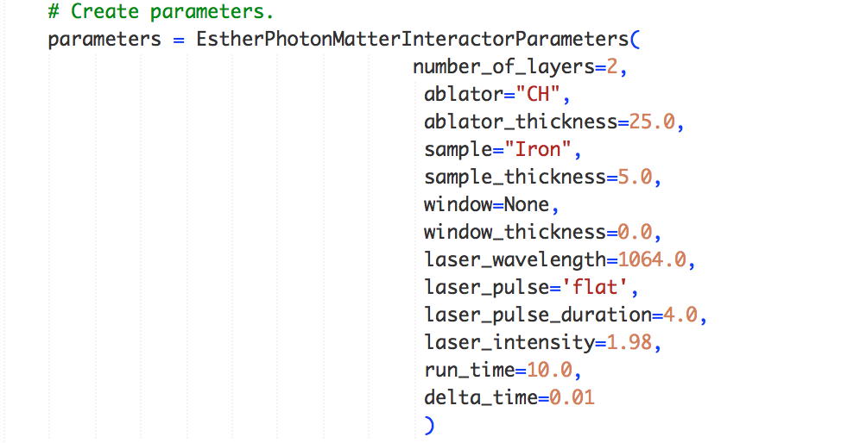
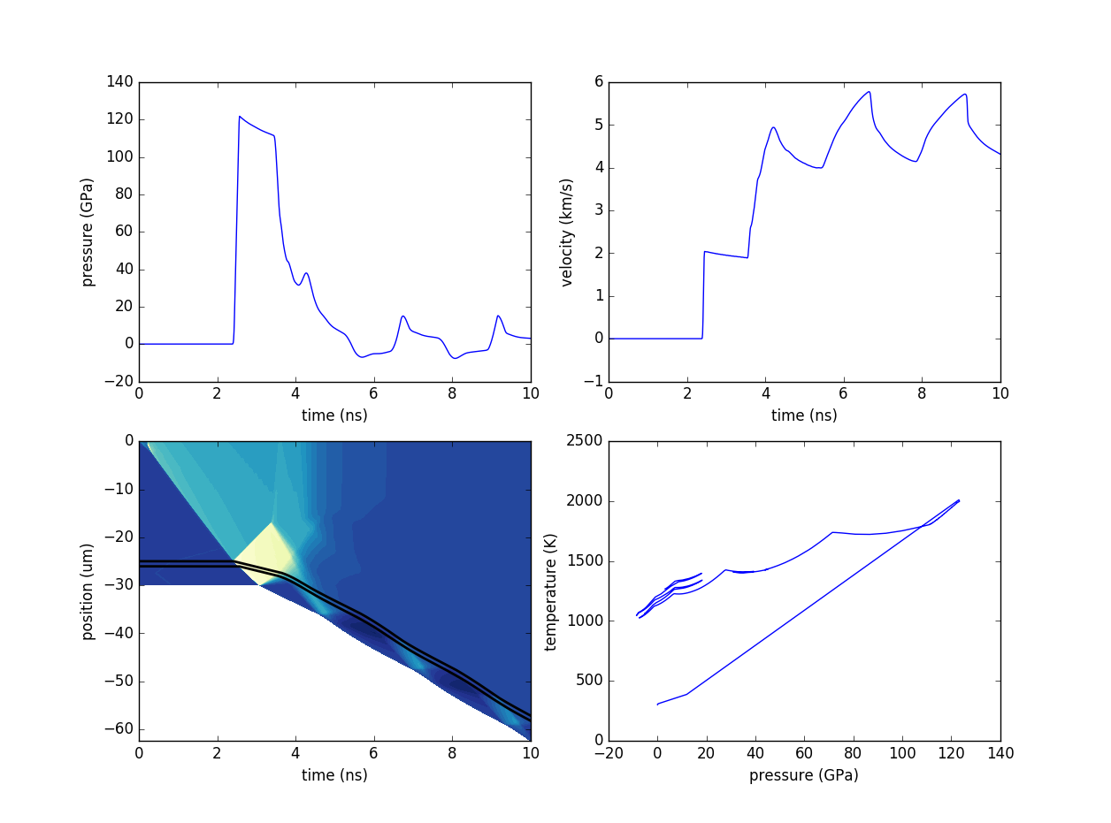
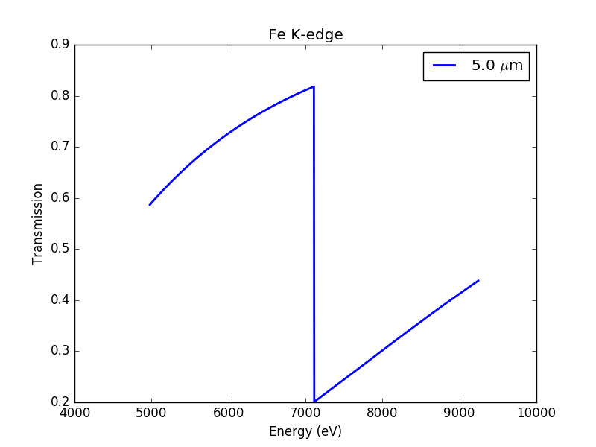
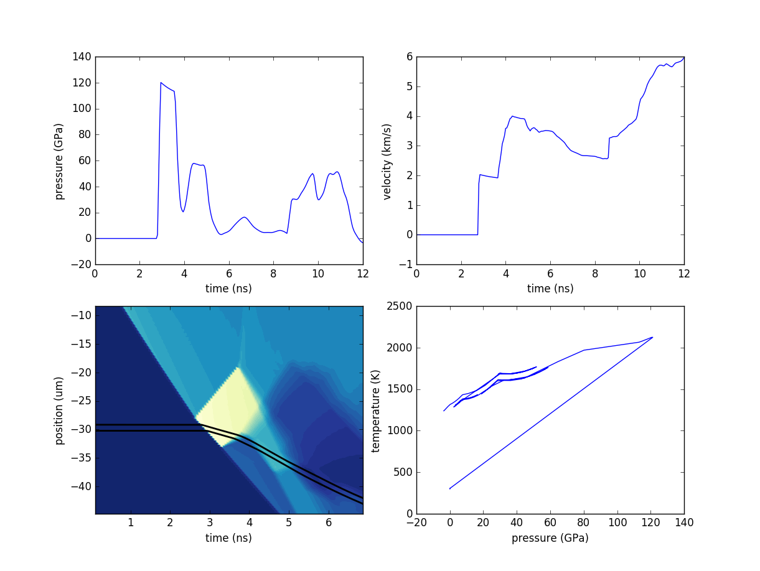
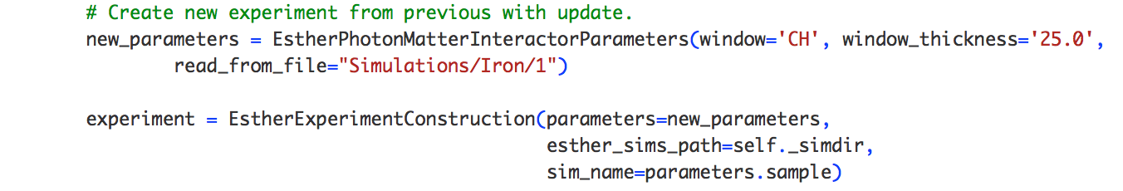
SIMEX assists in target design optimization for dynamic compression experiments at ESRF
5 µm Fe
25 µm CH
1064 nm
4 ns
1.98 TW/cm²
→ Setup calculation parameters →Run calculation → Analyze results →
Initial sample target design.
5 µm Fe
←Re-design (add window layer to confine target) ←
25 µm CH
25 µm CH
1064 nm
4 ns
1.98 TW/cm²
→ Update calculation parameters →Run calculation → Analyze results →

Slide 22
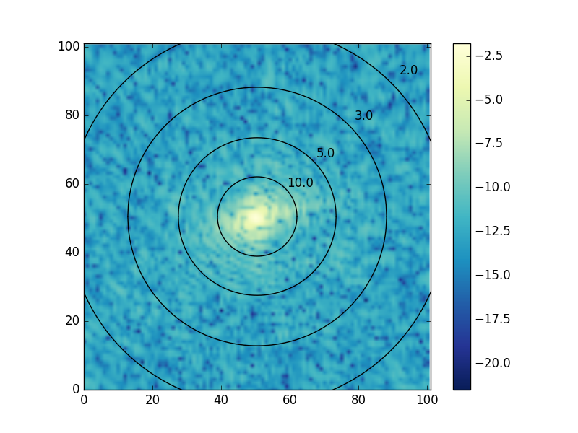
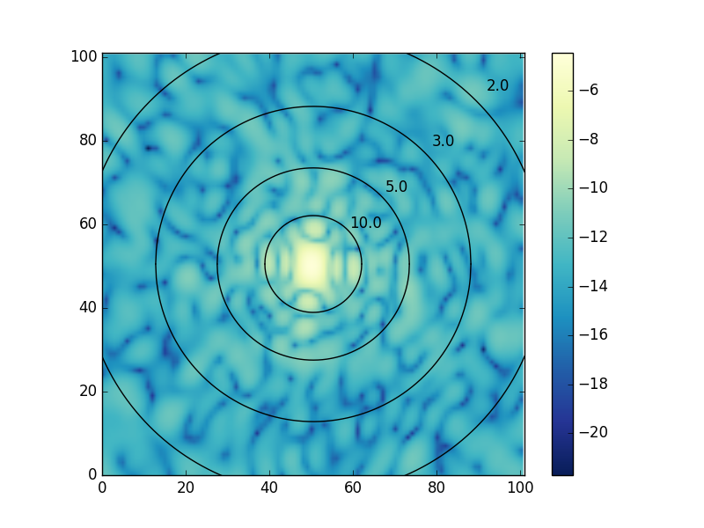
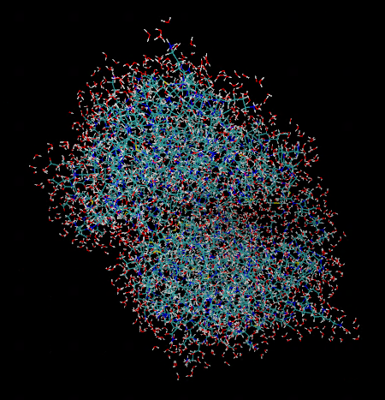
Single particle imaging of biomolecules
2NIP + 3Å H₂O
pure protein (2NIP)
2NIP imaging at various pulse duration: C. Fortmann-Grote et al. (under review).

Slide 23
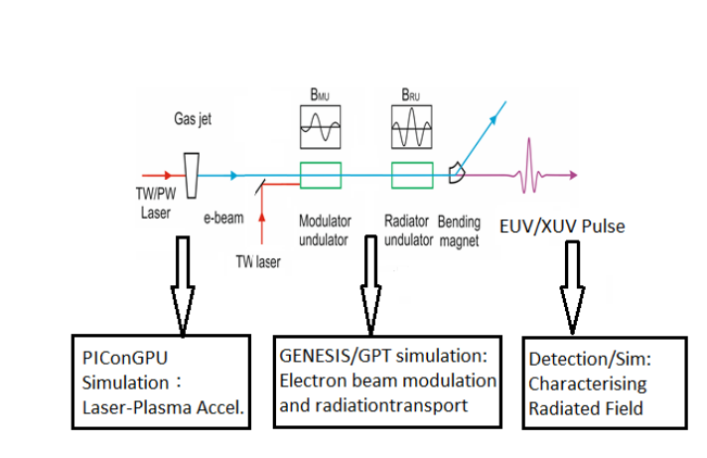

Laser-plasma acceleration based x-ray source
Simulate laser wakefield acceleration (PIC)
Feed electrons into FEL simulation code
New and hot topic, extension of EUCALL proposal

Slide 24
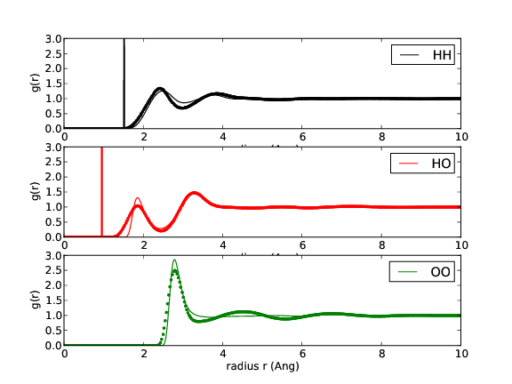
Our MD simulations reproduce characteristic features of the pair distribution function g(r)
reference data [Soper,ISRN Phys. Chem. (2013)]
MD

Slide 25
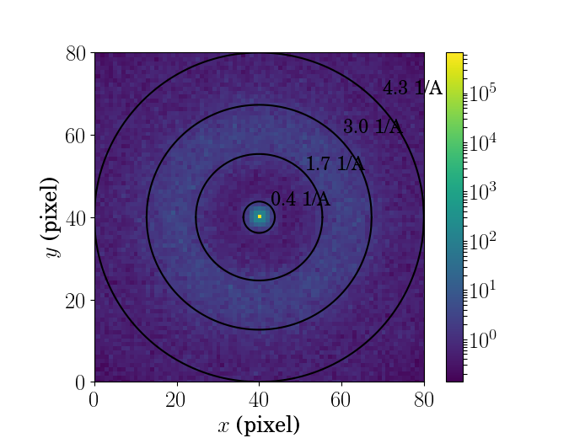
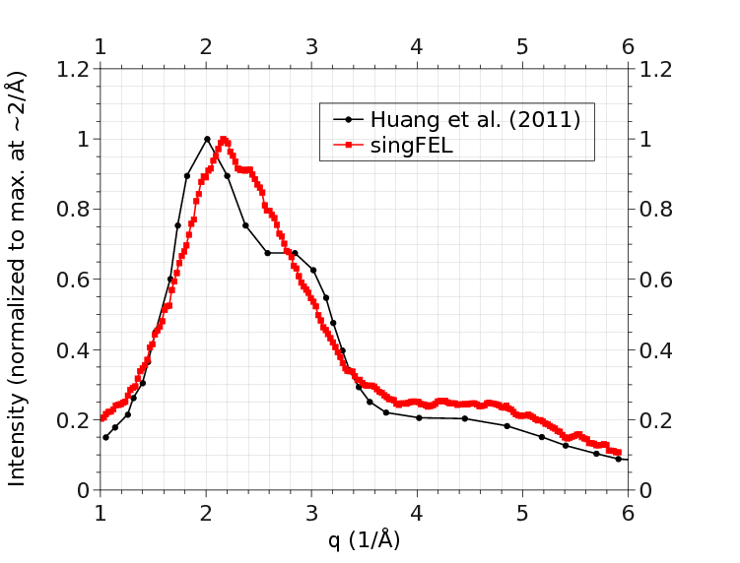
SimEx diffraction patterns exhibit the water ring (first correlation peak) in good agreement with reference experimental data.
Diffraction pattern from R=10 nm H2O sphere
photon energy = 24 keV
Det.-Sample distance 13 cm
Pixel size 1.2 mm
Radial projection

Slide 26
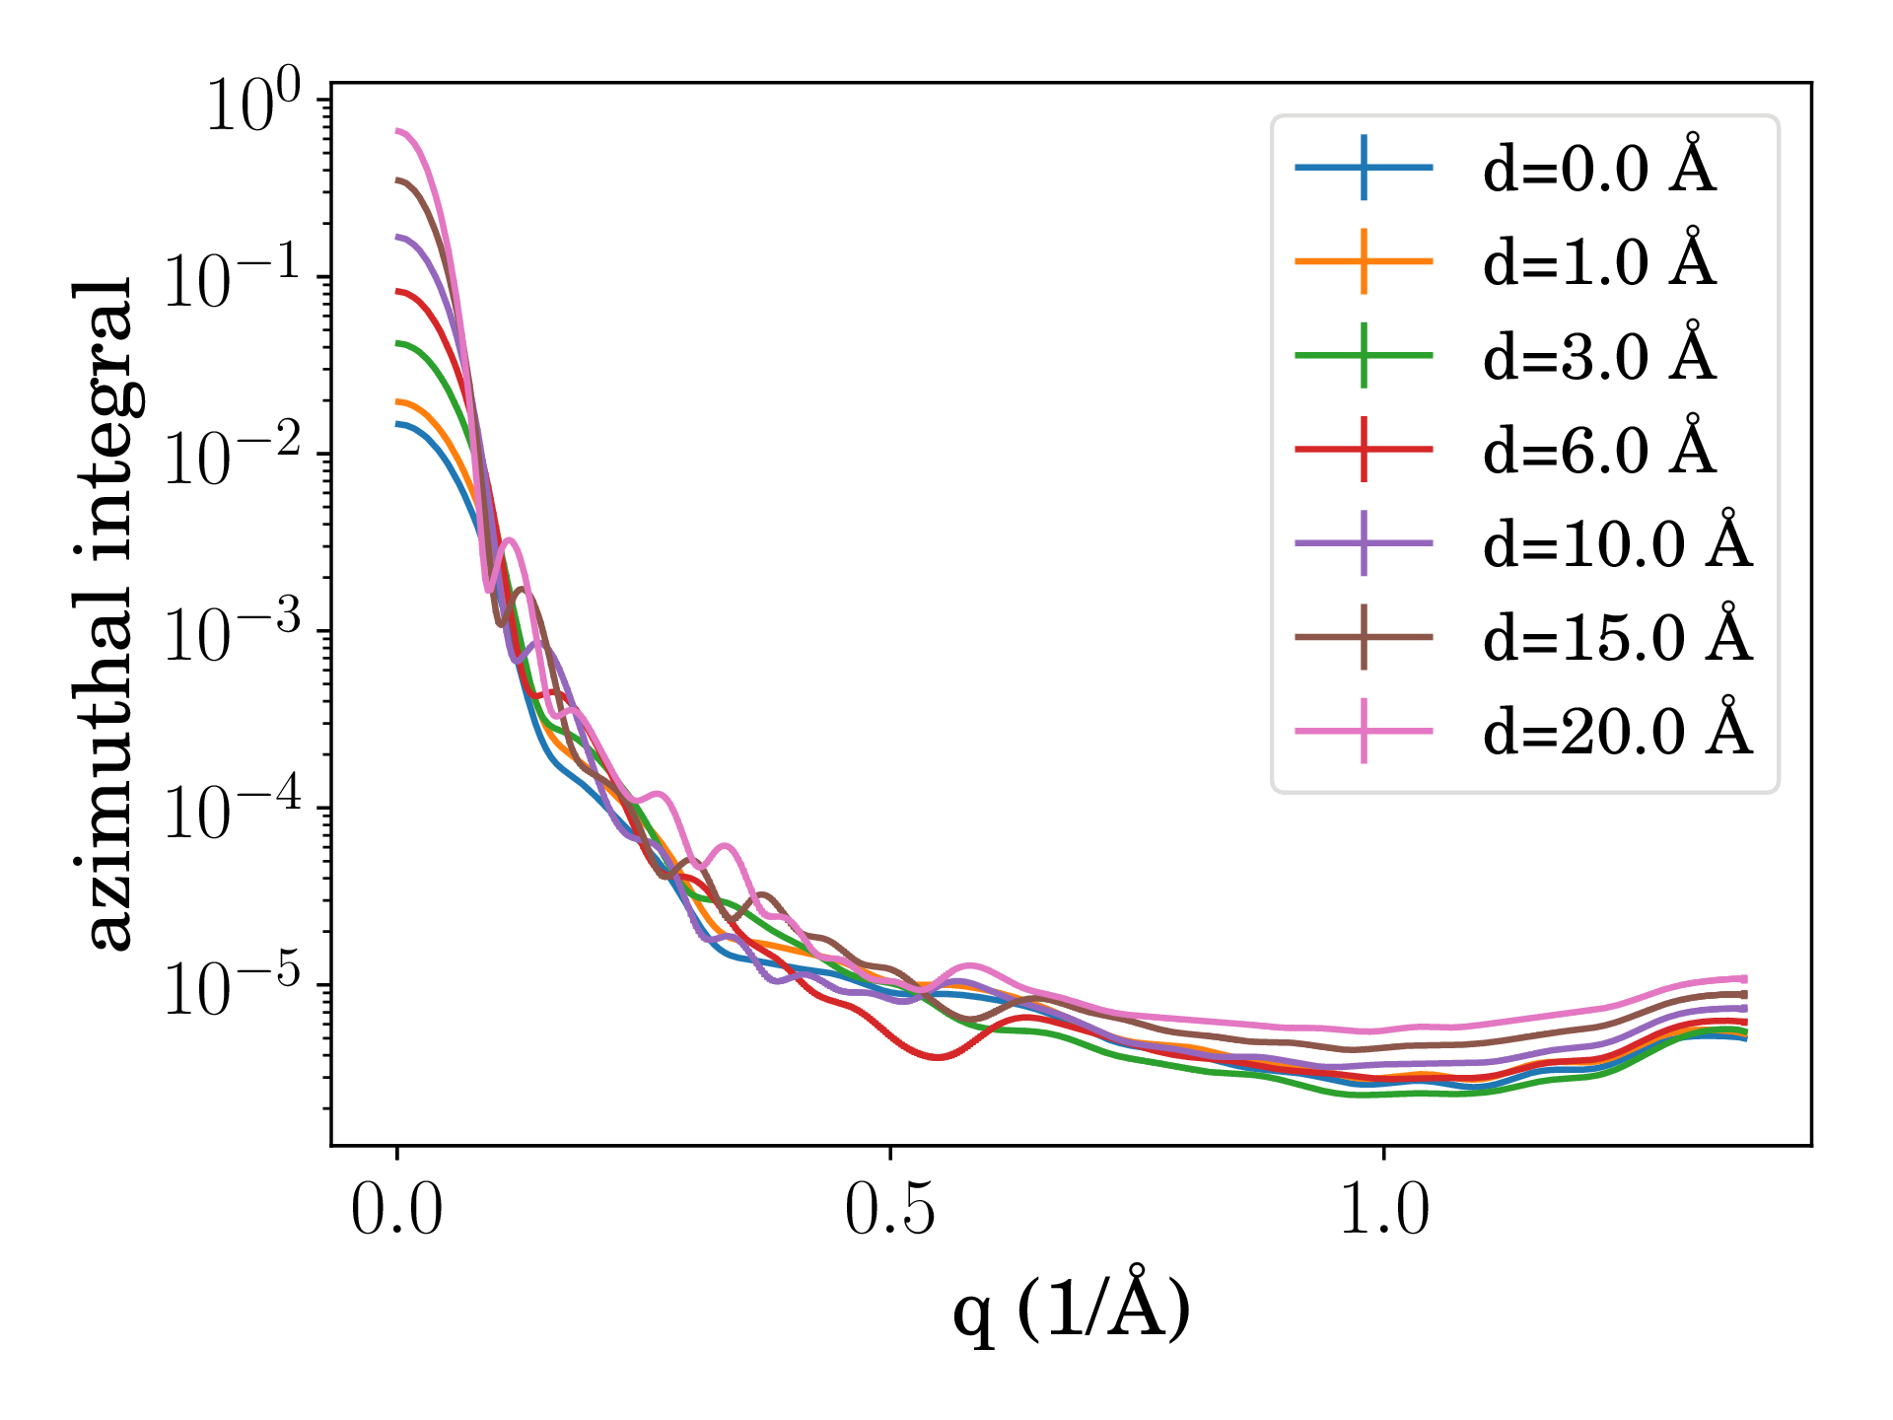
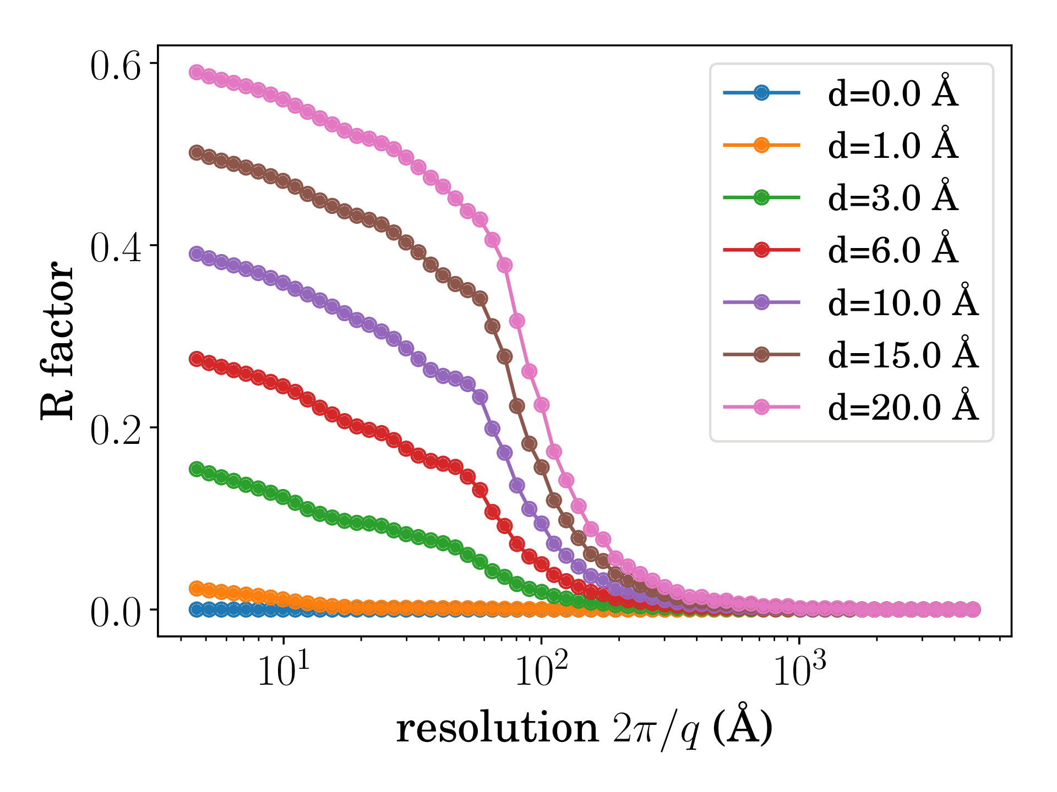
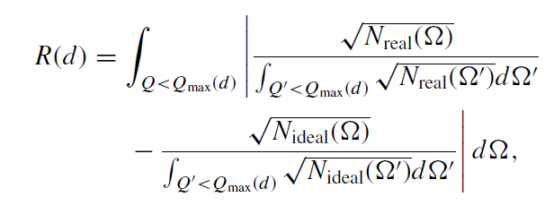
Our simulations support feasability of SPI at < 10 A resolution despite water layer of ~ 3 A
Sample size
Surface roughness
Background

Slide 27
Future of SIMEX

Slide 28
SIMEX is the nucleation point for a multiphysics, multiscale, interactive virtual science lab
Research Infrastructures
Research Areas
Visualization
Interactive 4D
Neutrons Electrons
Optical Lasers
Equation of State
Energetics
Ultrafast dynamics
2D/3D static plots
XFELs Synchrotrons
Structure resolution
Interactive
On demand
Batch (SLURM)
HPC
SIMEX
Disc I/O
HDF5
Caching
Database
Archives
Data handling
Scriptable user interfaces
simex_ platform
Select exp. data
Controls
DAQ
DAn
Algorithms
Simulation envs
GUI
CLI
Web frontend
Benchmark
protocolls,
standards,
database
User Interfaces
Frameworks
Validation

Slide 29
Benchmarking Experiments Against Modeling and Simulation (BEAMS)
Close the loop between experiments and theory by benchmarking experiments against detailed simulation in the photon sciences
Include other “beam-like” fields: e.g. neutron, astro, HEP
modeling experiments feasible at today’s facilities and benchmarking the results of experiments to the modeling
  improved understanding of physics
  more accurate forward models of physical phenomena
Include rapid data analysis
  Feedback for potentially data hungry experiments.
Potential (natural) partners
  EUCALL: SIMEX , UFDAC
  CFEL, ILL, MAX IV, ESS
  Astronomy/Astrophysics groups, HEP community

Slide 30



SIMEX as a Service
Backend daemons
Authorize user
Find resource
Organize data transfer
Submit job to resource
Provide job status
Submit job
BATCH
HPC
CLOUD

Slide 31
SIMEX-UFDAC cross-over
Monitor changes in observables as function of machine settings (online, real-time)
Feedback
  tuning, optimization
  gradient methods, genetic algorithms
Comparison exp ↔ sim online/offline
Data analysis, algorithm training
Data formats, metastandards (openPMD, nexus, ...)
Data deposition, re-use, update

Slide 32

Summary and Conclusions
SIMEX achieved Milestones and Deliverables up to date.
On track for M24 Ms&Ds.
M36 Ms&Ds are in progress.
simex_platform is exploited for scientific endeavors.
Future plans for SIMEX are beginning to emerge.

Slide 33
Thank you for your attention
www.eucall.eu / contact@eucall.eu
Notes:
How to edit the title slide
Upper area: Title of your talk, max. 2 rows of the defined size (36 pt)
Lower area (subtitle): your name and affiliation, max. 1 rows of the defined size (28 pt)

